Slide 1


Ebonics in the Classroom:
Effects on Student Reading and Writing

Slide 2
Legislation
-The Oakland Unified School Board
-December 1996
-Incorporation of Ebonics diction into the classroom

Slide 3
Controversy
“The district contends black English is the primary language of many of its black students. By recognizing Ebonics, Oakland officials said they hoped to improve the way black students are taught to read and write standard English.”

Slide 4
-Official status of Ebonics?
-Primary Language vs. Dialect
-“Instruction will be imparted in the primary language”
-Ebonics speakers termed “bilingual”
-Backlash: Focus of Issue

Slide 5
Motives Ignored
-Where the attention was directed
-Where it should have been directed:
“An estimated 53 percent of Oakland's nearly 52,000 students are black, and district officials say they have the lowest grade point averages in the district”

Slide 6
Logic Behind the Issue
-Washington and Miller-Jones –1989
“Teachers' knowledge of the phonological, syntactical, and stylistic features of Ebonics was significantly related to the ways they responded to the reading miscues of Black children demonstrating different levels of Ebonics use.

Slide 7
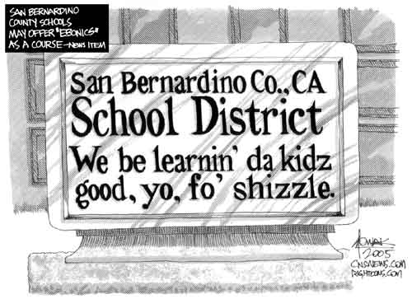
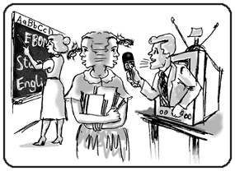
…The teacher who was more knowledgeable of Ebonics evidenced more behaviors considered to be supportive of the reading development of Ebonics speakers”

Slide 8
Research Question
Implementation of Ebonics in Classrooms:
What are the effects on reading and writing performance for African American students?

Slide 9
Methodology
-Test scores from 1986 to 2006
(10 years before, 10 years after)
-Schools: highest concentration of African American students
-Significant increase or decrease in scores should give greater understanding of effectiveness

